Slide 1
Status of Women and Girls in a Changing Arab Region
UNDP Regional Consultation
Amman, Jordan
May 22-23,2017

Slide 2
CEDAW Reservations
Algeria
Bahrain
Egypt
Iraq
Kuwait
Lebanon
Morocco
Oman
Qatar
Saudi Arabia
Syria
UAE
Yemen
Algeria
Bahrain
Iraq
Kuwait
Lebanon
Morocco
Oman
Qatar
Saudi Arabia
Syria
UAE
Algeria
Bahrain
Egypt
Iraq
Kuwait
Lebanon
Libya
Qatar
Saudi
UAE
Algeria
Bahrain
Egypt
Iraq
Libya
Morocco
Qatar
Syria
UAE
Algeria
Bahrain
Morocco
Oman
Qatar
Saudi
UAE

Slide 3
Gender Equality and the SDGs
Notes:
Cross cutting:
Attitudes (IMAGES)
Perception (i.e. women in power)
Social barriers
Positive policies
Dialogue across inter-faith
South-south exchange
Member state driven

Slide 4
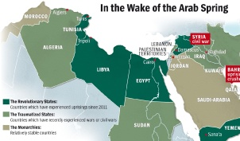
Women’s Political Participation
11 countries with reservations to
CEDAW Article 9 on Nationality
Algeria
Bahrain
Iraq
Kuwait
Saudi Arabia
Syria
UAE
Lebanon
Morocco
Oman
Qatar
Challenges
CONFLICTS
Capacity
Social Norms
The global average for women national parliamentarians is 22.8%.
In the Arab States, it is 18.4%.
Opportunities
Support legal frameworks
Expand the pool of qualified and capable women
Transform gender norms
Support women leaders
Advocacy
Challenging gender norms
Target duty-bearers and beneficiaries
Capacity building of CSOs
Women’s networks
Policy-level lobbying
Knowledge sharing and South-South exchange
Capacity building of women leaders

Slide 5
Women’s Economic Empowerment
Challenges
Arab States Region is ranked sixth and last in the Gender Gap sub-index on economic participation.
Number of years it would take the Arab States to catch up to global women’s labour participation at current rates
Only 40% of the gender gap has been closed.
145 =
CEDAW Reservations | No. of Countries
Article 15 – law and contracts | 11 Countries
Article 16 – property | 11 Countries
Gender norms
Unpaid work and unemployment
Vulnerable employment
Legal Frameworks
Opportunities
Employment creation for women
Labor laws and government policies
Recognizing and redistributing unpaid care work
Social protection
Challenging gender norms
Protection measures – maternity, care, flexibility, transport
Building CSO capacity
Promoting decent work
Reform discriminatory laws
Increasing private sector employment
Engender public policies

Slide 6
Ending Violence Against Women
Challenges
1 in 7
is married as a child
Constitution referring to VAW | 2 Countries
Existing Law on Domestic Violence | 6 Countries
National strategy on VAW | 7 Countries
Sexual Harassment
Attitudes & Social Norms accepting VAW
CONFLICTS
Opportunities
Need for enabling legal frameworks
Changing social norms and gender stereotypes
Data collection on VAW
Provision of quality services to survivors
Advocacy
Challenging gender norms
Essential Services Package
Capacity building of CSOs
Knowledge sharing and Exchange
Building national capacities
Education

Slide 7
Women, Peace and Security
Situation
Yemen
3rd year of war
Political talks stalled
Humanitarian crisis
Impending famine
Libya
Contested governing authority
Women represented in limited numbers
Targets of violence
Restricted movement
Syria
6th round of UN peace talks – 3 women have been involved
Intra-Syrian talk planned for June
Iraq
National reconciliations remain high priority
Talks in Switzerland and Turkey
Projects to resolve crisis
Women locked out
Opportunities
Enabling environment
Women’s participation in decision-making processes
Women’s participation in peace negotiations
Protect human rights
Advocacy with Civil Society
Conflict prevention and peacebuilding
Gender quota
Support local WPS organizations
Support women’s engagement
Research and document HR violations
Provide gender expertise
Building national capacities to fund and implement NAP for UNSCR 1325

Slide 8
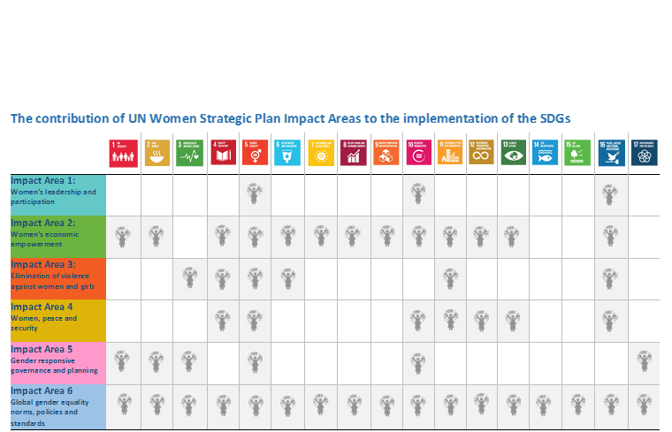
Gender Equality and the SDGs
Notes:
Cross cutting:
Attitudes (IMAGES)
Perception (i.e women in power)
Social barriers
Positive policies
Dialogue across inter-faith
South-south exchange
Member state driven

